Slide 1

Statistical analysis of Diabetes in pima indians
PRESENTATION
Notes:
Welcome to this presentation covering statistical analyses of diabetes in Pima Indians.

Slide 2

agenda
Introduction
Data exploration & descriptive statistics
Inferential statistics
Summary of analysis
Recommendations
Notes:
This presentation will cover the following topics: a background of diabetes and how it relates to Pima Indians, as well as an overview of the context behind the data analysis and methods used, an exploration of the data and its descriptive statistics, inferential statistics, a summary of the statistical findings, and recommendations for future research and analysis.

Slide 3
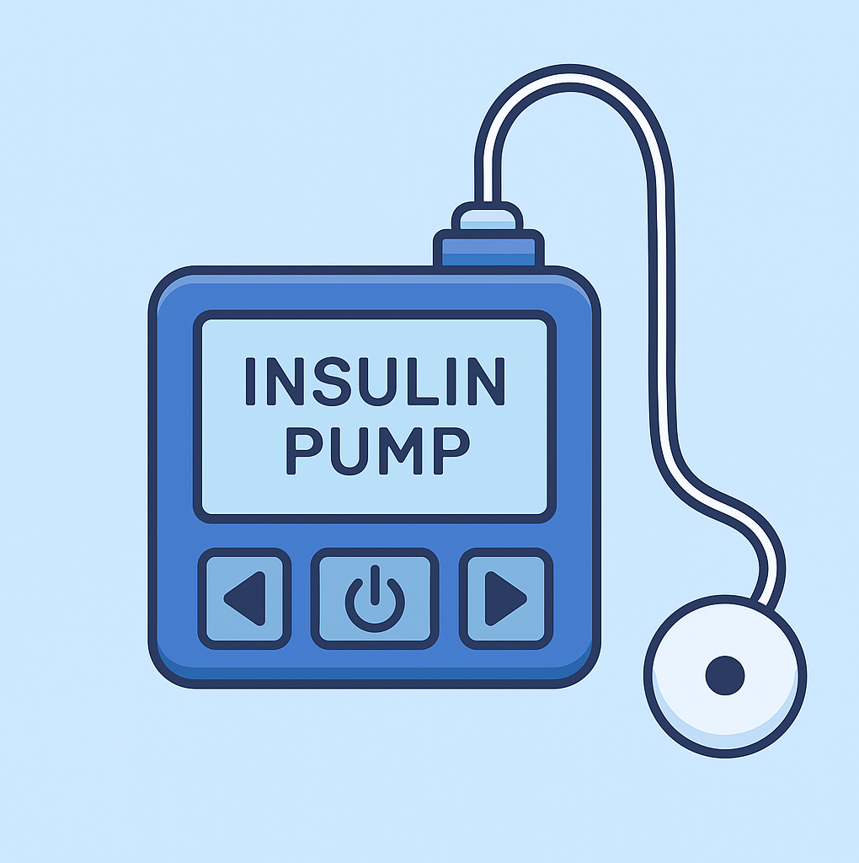
Introduction to diabetes
Diabetes affects 590 million adults globally (International Diabetes Federation, 2025).
By 2050, it is projected that 853 million adults will be diagnosed with the condition (International Diabetes Federation, 2025).
Pima Indian population has one of the highest recorded rates of diabetes (Narayan et al., 2021)
OpenAI (2025)
Notes:
Diabetes is a disease which affects millions of individuals across the globe, and is a prominent public health concern. Currently, 590 million adults were living with diabetes, and according to the International Diabetes Federation (2025). This figure is anticipated to increase to 853 million adults by 2050.
According to Narayan et al’s (2021) research, the Pima Indian population has one of the highest rates of diabetes globally. This population is often used by analysts to investigate the risk factors of diabetes.

Slide 4
Overview of dataset
Diabetes dataset analysed – descriptive and inferential statistics were generated
All participants are women of Pima Indian heritage, older than 21 years
R used to perform analysis – ease and simplicity of use
Notes:
The dataset ‘Diabetes’, originally from the National Institute of Diabetes and Digestive and Kidney, was collected to determine and predict whether a diabetes diagnosis is influenced by various diagnostic variables.
This dataset was analysed using descriptive and inferential statistical analytical methods. This presentation will showcase the findings of the analyses conducted, with the aim of concluding which variables predict diabetes.
All participants in the dataset are women of Pima Indian heritage and are at least 21 years old.
R was used to perform this analysis since it is a free, open-source statistical programming tool. Its user-friendly interface makes data analysis a much simpler task.

Slide 5
Data exploration and
descriptive STATISTICS

Slide 6
Data exploration
Total Sample | 768
% of people diagnosed with diabetes | 34.90
Age distribution | Mean age – 33.24; median age - 29
Pregnant women | 657
Non-pregnant women | 111
Percentage of sample with diabetes higher than global population
Younger group of women in sample
Vast majority of women have been pregnant
Notes:
The dataset was explored and here are some descriptive statistics found.
The total sample size of the dataset is 768, so it is a fairly large dataset. 34.9% of individuals in the sample have been diagnosed with diabetes, which is far higher percentage compared to the 11% of people with diabetes in the global population.
The mean and median age figures of 33.24 and 29 respectively shows that it is a younger group of individuals.
86% of women in the sample population have been pregnant, which is a vast majority.

Slide 7
descriptive statistics
 | Age | BMI | Glucose | Blood Pressure | Number of Pregnancies
Mean | 33.24 | 32.46 | 121.69 | 72.41 | 3.58
Median | 29.00 | 32.30 | 117.00 | 72.00 | 3.00
Mode | 22 | 32 | 99 | 70 | 1
Minimum | 21.00 | 18.20 | 44.00 | 24.00 | 0.00
Maximum | 81.00 | 67.10 | 199.00 | 122.00 | 17.00
Range | 60.00 | 48.90 | 155.00 | 98.00 | 17.00
Standard Deviation | 11.67 | 6.92 | 30.54 | 12.38 | 3.70
Range: indicates diversity across sample
BMI: more individuals are obese
Glucose: levels across the group are higher
Blood pressure: average reading is within normal range
No. pregnancies: most women have only experienced 1 pregnancy
Notes:
Here is a table displaying the mean, median, mode, minimum & maximum values, range, and standard deviation for the variables age, BMI, glucose, blood pressure, and pregnancies.
The ranges for each variable shows that there is a lot of diversity in terms of age and lifestyle across the women in the sample, and this warrants further exploration.
With a mean BMI of 32.46 and mode of 32, it indicates that more individuals in the group are in the obese range. The mean glucose level of 121.69 indicates that levels in the group are higher. On average, the blood pressure of the women in the group is within a normal range.
Most women who have been pregnant have only had one pregnancy, as indicated by the mode.

Slide 8
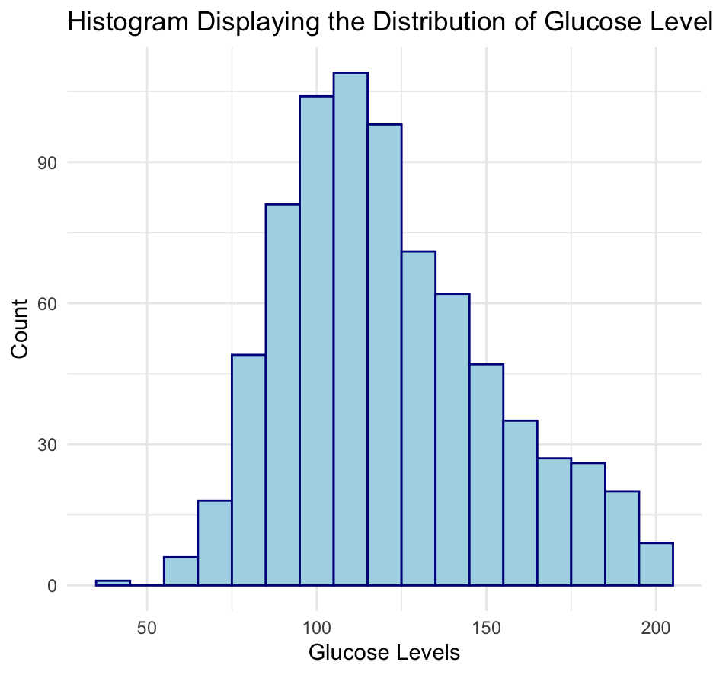
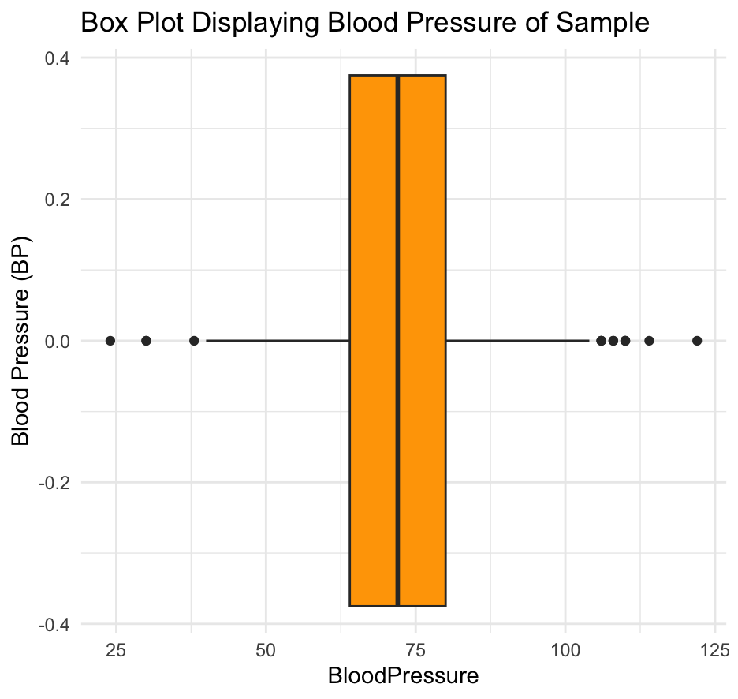
Plots for glucose and blood pressure scores
Distribution of glucose levels is quite normal
Distribution of blood pressure readings is quite normal
Notes:
Here are the plots for each of the variables, which essentially visualises the table in the previous slide.
It’s clear that the distributions for both glucose levels and blood pressure are quite normal, and their means are quite central.

Slide 9
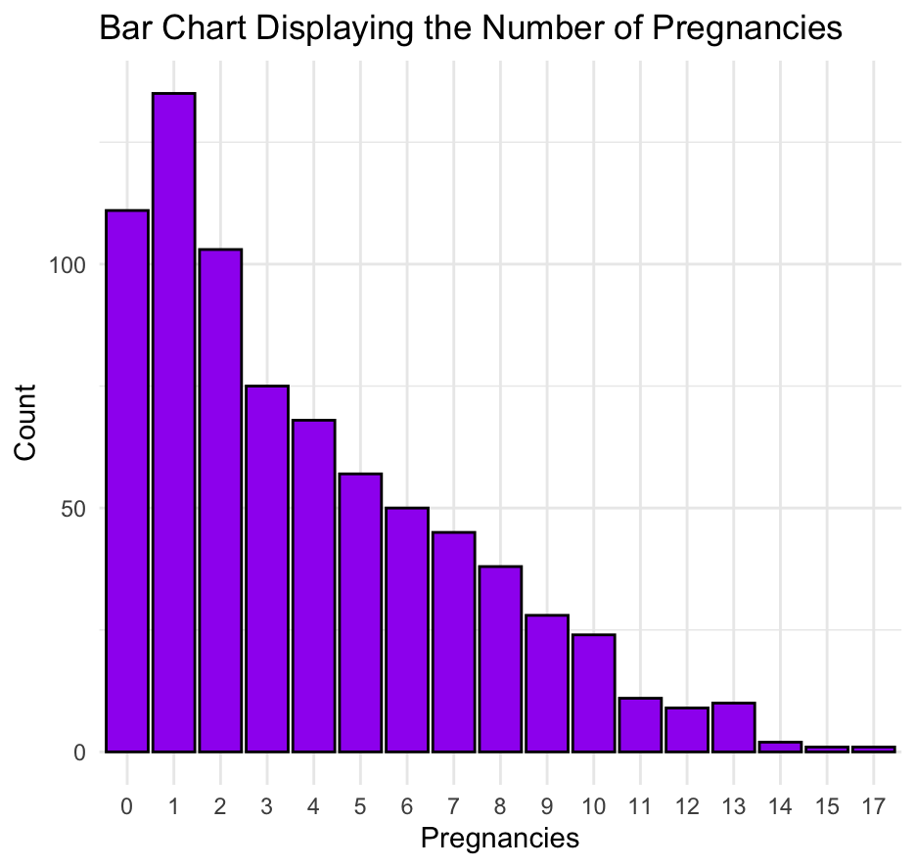
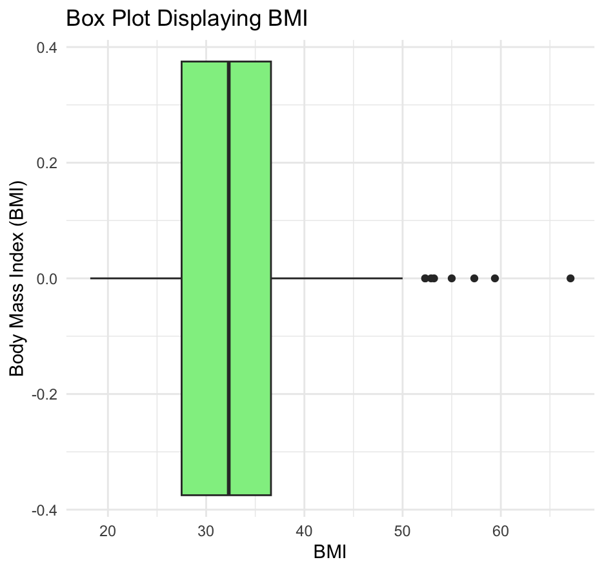
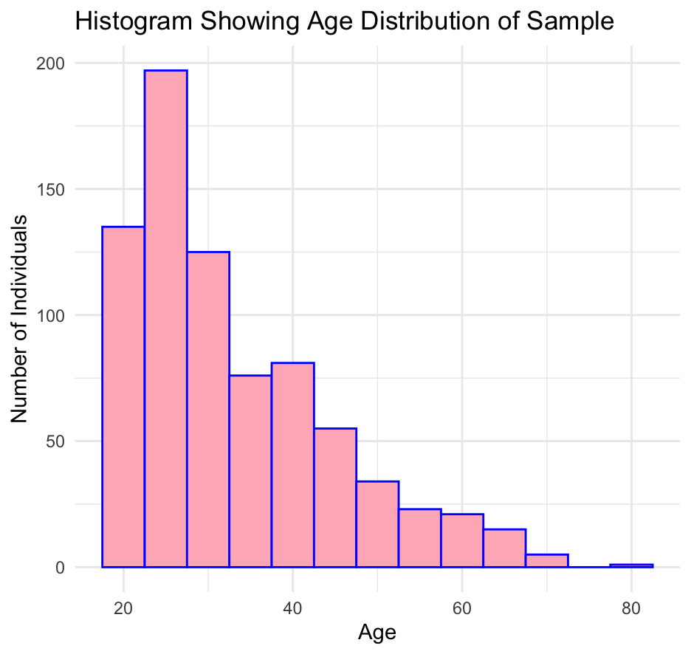
Plots for age, bmi and pregnancies
No. pregnancies, BMI, and age all skewed right
Notes:
However, the scores for the age, BMI, and pregnancies variables are really skewed. Pregnancies is skewed to the right, which means most women have a lower number of pregnancies. Age and BMI are also quite skewed to the right too.

Slide 10
Outliers
Interquartile range (IQR) method used to identify any outliers for the age, BMI, glucose levels, blood pressure, and no. pregnancies.
Outliers identified for age, BMI, blood pressure, and pregnancies.
BMI outlier scores an occurrence (Flegal, Kit and Graubard, 2014)
Low scores for blood pressure unrealistically low (Kelly et al, 2022) – these values were excluded from dataset.
Hugh blood pressure scores retained due to hypertension coexisting with diabetes (Przezak, Bielka and Pawlik, 2022)
High pregnancy scores retained as it is a possibility (Tamir et al, 2025)
Age | BMI | Glucose Levels | Blood Pressure | Pregnancies
9 | 8 | 0 | 14 | 4
Variable | Outlier values
Age | 67, 67, 67, 68, 69, 69, 70, 72, 81
BMI | 52.3, 52.3, 52.9, 53.2, 55, 57.3, 59.4, 67.1
Blood Pressure | 24, 30, 30, 38, 106, 106, 106, 108, 108, 110, 110, 110, 114, 122
Pregnancies | 14, 14, 15, 17
Notes:
Using the Interquartile Range (IQR) method, outliers were identified for Age, BMI, Blood Pressure, and No. Pregnancies. The outlier values within each variable are listed in the table on the right-hand side.
The outlier values for age are: 67, 67, 67, 68, 69, 69, 70, 72, 81. For BMI, the values are 52.3, 52.3, 52.9, 53.2, 55, 57.3, 59.4, 67.1. For blood pressure, there are 14 values: 24, 30, 30, 38, 106, 106, 106, 108, 108, 110, 110, 110, 114, 122. For the number of pregnancies, there are 4 values: 14, 14, 15, and 17.
To manage these, each individual variable had to be considered along with whether those values are just realistic but rare cases. With age, the risk of developing diabetes increases (The Lancet Diabetes & Endocrinology, 2025) so in this case, it’s likely that the outlier values are just genuine variations in the sample population. Therefore, they were retained in the dataset for analysis.
For the outlier BMI scores, they are all on the higher end, which is an occurrence in the population and indicates severe obesity, according to Flegal, Kit and Graubard (2014) As a result, they were also retained in the dataset.
The lower outlier values (24, 30, 38) for BP are unrealistically low as typically, diastolic BP is ≥ 60 mmHg (Kelly et al, 2022) . This implies that these values are erroneous, potentially caused by incorrect entry of the data. As a result, these values were excluded from the dataset for future analysis. On the other hand, the higher outlier values (106-122) are physiologically possible in individuals who have diabetes as hypertension and diabetes often coexist (Przezak, Bielka and Pawlik, 2022). As a result these values were retained in the dataset.
Pregnancy outlier values were retained in the dataset too as although it is uncommon for a woman to have more than 14 pregnancies, it is a possibility, especially in countries within Southern Asia (Tamir et al., 2025).

Slide 11
Rate of diabetes across age group, bmi category, and pregnancy group
Age Group | Diabetes Rate (%)
<30 | 20.4
30-39 | 45.2
40-49 | 54.9
50+ | 48.9
Body Mass Index (BMI) Category | Diabetes Rate (%)
Underweight | 0
Normal | 7.29
Overweight | 22.2
Obese | 45.2
NA | 25
Pregnancy Group | Diabetes Rate (%)
0 | 31.7
1-2 | 19.9
3-4 | 34.3
5+ | 47.9
Age group: <30 group had lowest rate of diabetes
BMI Category: diabetes rate increases as BMI increases
Pregnancy group: diabetes rate highest in 5+ pregnancies group
Notes:
Here we are reviewing the rate of diabetes across the different age groups, BMI categories, and pregnancy groups.
Ages were categorised into groups ( under 30, 30-39, 40,49 and 50+). The rate of diabetes was lower in the <30 group, and increased starkly to the 30-39 age group. From there, the rate of diabetes was similar.
BMI was categorised into four categories: underweight (< 18.5), normal (18.5–24.9), overweight (25–29.9), and obese (≥30). These are widely accepted categories for BMI used globally (World Health Organization, 2025). BMI was not recorded for 4 participants. The rate of diabetes increases as BMI increases, which is a well-reported relationship.
Four pregnancy groups were created (0, 1-2, 3-4, 5+). The rate was lower amongst group of participants who had 1 or 2 pregnancies and highest amongst those who had experienced more than 5 pregnancies. Gestational diabetes can occur in pregnant women, and risk of developing this increases as the age of the expectant mother increases and this is supported by Li et al.’s meta-analysis of gestational diabetes and age (2020).

Slide 12
INFERENTIAL STATISTICS

Slide 13
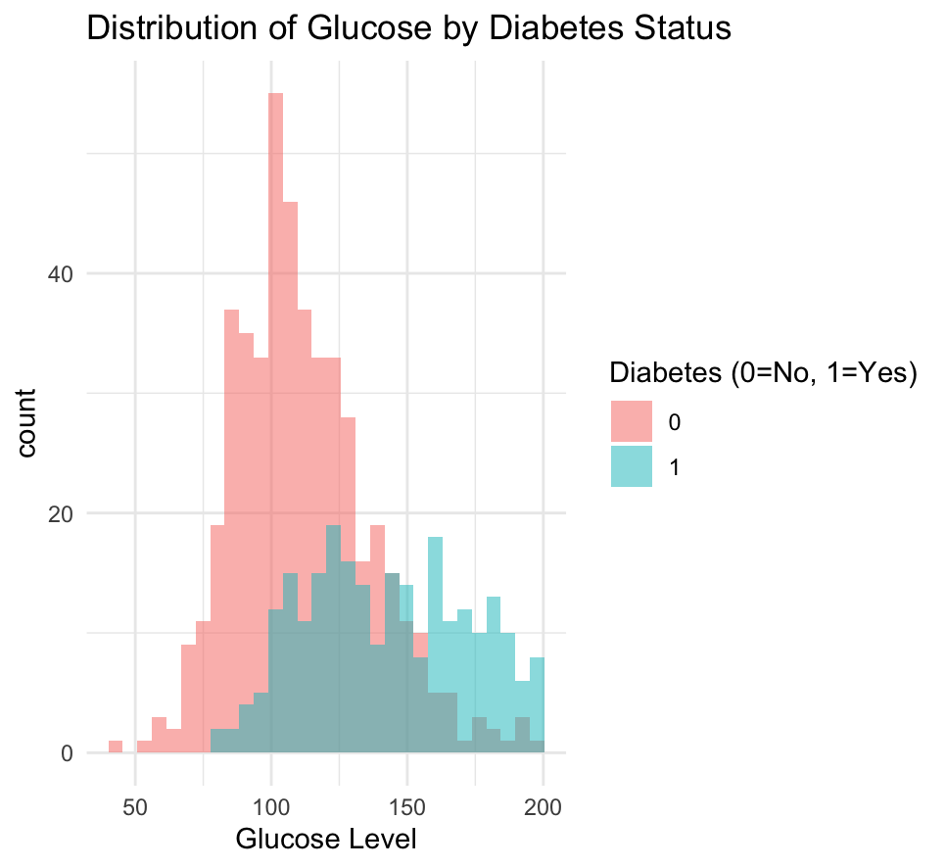
Is there a significant difference in glucose levels between those with and without diabetes?
Glucose levels – a continuous variable
Diabetes diagnosis – a categorical variable
Test of normality of glucose levels:
Shapiro-Wilk:
Group | W | P-value
With Diabetes | 0.97 | p<0.001
Without diabetes | 0.97 | p<0.001
Notes:
To answer this question, first, as glucose levels is a continuous variable, a normality test was run to determine whether the data is normally distributed, as this inform the statistical test used.
The Shapiro-Wilk test was used to determine the normality of the levels of glucose for the group with diabetes and the group without. The p-value for both groups was <0.05 which indicates that the data is not normally distributed. However, this is a large dataset (729 rows in the dataset without outliers/missing values) and the Shapiro-Wilk test is sensitive when the sample size is this large.
The W statistic is 0.97 for both groups and is close to 1, which shows that the data is quite close to normal.
Also, a histogram of the glucose scores by diabetes diagnosis visually displays the normal distribution of both groups. As a result we can be confident that the data is normal and use a parametric test.
An independent samples t-test is the most appropriate statistical test as the glucose levels is a continuous variable, and diabetes diagnosis is a categorical variable split into 2 groups independent of each other. And since the glucose levels are normally distributed, the mean levels of the two groups can be compared.

Slide 14
Is there a significant difference in glucose levels between those with and without diabetes?
Hypotheses:
H₀ – There is no significant difference in glucose levels between individuals with and without diabetes.
H₁ - There is a significant difference in glucose levels between individuals with and without diabetes.
Group | Mean Glucose | T(df) | 95% CI | P-value
Non-diabetics (0) | 111.13
Diabetics (1) | 142.76 | t(433.19) = -14.28 | (-35.98, -27.27) | p<0.001
Notes:
Two hypotheses were created for this analysis:
- The null hypothesis: that there is no significant difference in mean glucose levels between individuals with and without diabetes.
The alternative hypothesis: that there is a significant difference in mean glucose levels between individuals with and without diabetes.
The p-value is less than 0.001, showing that there is a significant difference in mean glucose levels between individuals with and without diabetes. Therefore, the null hypothesis is rejected and the alternative hypothesis is accepted.

Slide 15
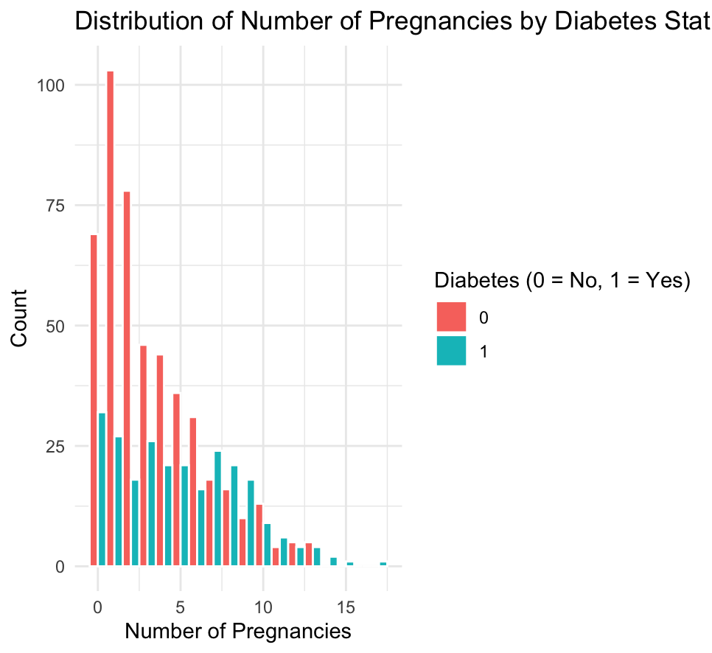
Is there a significant difference in the number of pregnancies between those with and without diabetes?
Number of pregnancies– a continuous variable
Diabetes diagnosis – a categorical variable
Test of normality of number of pregnancies:
Shapiro-Wilk:
Group | W | P-value
With Diabetes | 0.95 | p<0.001
Without diabetes | 0.88 | p<0.001
Notes:
Similar to the previous question, a normality test was run to determine whether the number of pregnancies is normally distributed to inform which statistical test should be used.
The Shapiro-Wilk test was used to determine the normality of the number of pregnancies for the group with diabetes and the group without. The p-value for both groups was <0.05 which indicates that the data is not normally distributed. The W statistics for both groups, particularly the group without diabetes, indicates that the data isn’t close to being normal.
The histogram on the right supports this as the data is skewed to the right, particularly for the non-diabetic group.
As a result, a non-parametric test should be used.
A Mann-Whitney U test is the most appropriate statistical test as the number of pregnancies is a continuous variable, and diabetes diagnosis is a categorical variable split into 2 groups independent, of each other. And since pregnancies aren’t normally distributed and skewed right, the medians of the two groups are compared rather than the means.

Slide 16
Is there a significant difference in the number of pregnancies between those with and without diabetes?
Hypotheses:
H₀ – There is no significant difference in the number of pregnancies between individuals with and without diabetes.
H₁ - There is a significant difference in the number of pregnancies between individuals with and without diabetes.
Test statistic (W) | P-value
44550 | p<0.001
Notes:
The null hypothesis is there is no significant difference in the number of pregnancies between individuals with and without diabetes.
The alternative hypothesis is there is a significant difference in the number of pregnancies between individuals with and without diabetes.
The p-value is less than 0.001, showing that there is a significant difference in the median number of pregnancies between the two diabetes status groups. Therefore, the null hypothesis is rejected and the alternative hypothesis is accepted. In layman terms, those with diabetes tend to have a different number of pregnancies compared to those without diabetes.

Slide 17
Correlations between all continuous variables
Correlation analysis conducted to assess relationship between continuous variables
Coefficients calculated to determine strength & direction and significance of relationship
 | No. Pregnancies | Glucose | Blood Pressure | Skin Thickness | Insulin | BMI | Diabetes pedigree function | Age
No. Pregnancies |  | 0.13 p<0.001 | 0.21 p<0.001 | 0.10 p=0.02 | 0.07 p=0.12 | 0.02 p=0.60 | -0.03 p=0.40 | 0.56 p<0.001
Glucose | 0.13 p<0.001 |  | 0.22 p<0.001 | 0.23 p<0.001 | 0.57 p<0.001 | 0.23 p<0.001 | 0.13 p<0.001 | 0.26 p<0.001
Blood pressure | 0.21 p<0.001 | 0.22 p<0.001 |  | 0.24 p<0.001 | 0.08 p=0.11 | 0.32 p<0.001 | -0.01 p=0.87 | 0.33 p<0.001
Skin Thickness | 0.10 p=0.02 | 0.23 p<0.001 | 0.24 p<0.001 |  | 0.19 p<0.001 | 0.65 p<0.001 | 0.18 p=0.01 | 0.17 p<0.001
Insulin | 0.08 p=0.12 | 0.58 p<0.001 | 0.08 p=0.11 | 0.19 p<0.001 |  | 0.24 p<0.001 | 0.13 p=0.01 | 0.22 p<0.001
BMI | 0.02 p=0.60 | 0.23 p<0.001 | 0.32 p<0.001 | 0.65 p<0.001 | 0.24 p<0.001 |  | 0.16 p<0.001 | 0.03 p=0.49
Diabetes pedigree function | -0.03 p=0.40 | 0.13 p<0.001 | -0.01 p=0.87 | 0.18 p=0.01 | 0.13 p=0.01 | 0.16 p<0.001 |  | 0.02 p=0.59
Age | 0.56 p<0.001 | 0.26 p<0.001 | 0.33 p<0.001 | 0.17 p<0.001 | 0.22 p<0.001 | 0.03 p=0.49 | 0.02 p=0.59
Notes:
A correlation analysis was conducted to examine the link between all of the continuous variables within the dataset, so the number of pregnancies, glucose levels, blood pressure, skin thickness, insulin, BMI, diabetes pedigree function, and age.
The correlation coefficients were calculated to determine the strength and direction of the relationship between the variables, as well as the significance of the correlations, which are the p-values show underneath the r-values or coefficients.
A strong positive correlation exists between Skin Thickness and BMI. That coefficient is +0.65 and lies within the strong positive correlation boundary of +0.60 to +0.79. From this, we can deduce that as skin thickness increases, the body mass and ultimately BMI increases too.
Moderate positive correlations exist between Pregnancies & Age, and Glucose & Insulin as those pairs have r-values of +0.56 and +0.57 respectively. Those values fall within the moderate boundary of +0.4 to +0.59.

Slide 18
The association between diabetes and bmi categories and age groups
BMI categories created in line with the World Health Organisation’s (2025) categories:
Underweight - <18.5; Normal – 18.5– 24.9; Overweight – 25 – 29.9; Obese – 30+
Age groups split by decade
<30; 30-39; 40-49; 50+
Chi-squares test of association found a statistically significant relationship between diabetes diagnosis status and both BMI categories and age groups.
Group | x² | df | P-value
BMI category | 69.57 | 3 | p<0.001
Age group | 67.79 | 3 | p<0.001
Notes:
To determine whether there is an association between diabetes diagnosis status and both BMI categories and age groups.
Four BMI categories were created in line with the World Health Organisation’s (2025) categories.
Four age categories were also created, split by decade.
As diabetes status, BMI category and age group are all categorical variables, a chi-squared test of association was used to determine is there was a significant association between status and both BMI category and age group.
The test found that there is a statistically significant relationship between diabetes status and BMI category, as well as between diabetes status and age group. The null hypotheses, that there is no significant relationship between diabetes & BMI category, as well as between diabetes & age group, is rejected. The alternative hypothesis, there is a significant relationship between diabetes & BMI category, and between diabetes & age group, is accepted.

Slide 19
Comparison of mean glucose levels per age group
Age Group | W | P-value
<30 | 0.95 | P<0.001
30-39 | 0.97 | p=0.003
40-49 | 0.98 | p=0.20
50+ | 0.98 | p=0.18
Shapiro-Wilk normality test
Age groups split by decade
Normality of glucose levels per age group tested using Shapiro-Wilk normality test
Homogeneity of variances tested using Bartlett test
K² = 7.15, df = 3, p=0.07
Hypotheses
H₀ – there is no significant difference in the distributions of glucose levels per age group
H₁ – there is a significant difference in the distributions of glucose levels per age group
Kruskal-Wallis test showed a significant difference in distribution of glucose levels
Age Group | Mean Glucose | Chi-squared | df | P-value
<30 | 115.06
30-39 | 126.25
40-49 | 125.16
50+ | 139.78 | 54.74 | 3 | p<0.001
Kruskal-Wallis test
Notes:
The next piece of analysis was to compare the mean glucose levels per age group and determine if there is a significant relationship between mean levels and age group.
The four age groups created previously were used in this analysis too. As mentioned in the previous slide, age group is a categorical variable. Mean glucose levels is a continuous variable.
To determine the test used, a normality test and a homogeneity of variances test were conducted to determine the normality of data and equality of variances between groups.
Testing the normality of the mean glucose levels using the Shapiro-Wilk test showed that scores for the <30 and 30-39 group are not normally distributed, whilst levels in the 40-49 and 50+ group are. As a result, normality cannot be assumed.
Bartlett's test of homogeneity of variances showed that there is not a significant difference in the variances in levels between age groups. As normality cannot be assumed, the Kruskal-Wallis test was used since there are 4 age groups in total, and the glucose levels for the <30 & 30-39 group are skewed. The K-W test is robust enough to handle this.
The test found that there is a statistically significant difference in the distributions of mean glucose levels per age group. Therefore, a significant relationship exists between glucose levels and age group.

Slide 20
Which variables predict glucose levels?
Aim: predict glucose levels based on Age, BMI, Pregnancies, Blood Pressure, Skin Thickness, Insulin, and Diabetes Pedigree Function.
Outcome variable – glucose levels
Predictor variables - Age, BMI, Pregnancies, Blood Pressure, Skin Thickness, Insulin, and Diabetes Pedigree Function
Hypotheses:
H₀ – there is no significant relationship between predictor variables and glucose levels
H₁ – there is a significant relationship between the predictor variables and glucose levels.
Model Summary
Multiple linear regression model developed is statistically significant overall (F(7, 380) = 35.84, p<0.001)
Most significant variables? Age (β = 0.59, p<0.001), Insulin (β = 0.13, p<0.001).
38.1% of the variance in glucose levels explained; 61.9% not explained
 | F-statistic | df | R² | P-value
Multiple Linear regression model | 0.59 | 7, 380 | 0.39 | p<0.001
Significance of multiple linear regression model
Predictor | Coefficient (β) | P-value
Age | 0.59 | p<0.001
BMI | 0.18 | 0.47
Pregnancies | 0.07 | 0.90
Blood pressure | 0.19 | 0.11
Skin thickness | 0.06 | 0.67
Insulin | 0.13 | p<0.001
Diabetes pedigree function | 4.01 | 0.27
Notes:
Which variables predict glucose levels?
The aim is to confirm whether Age, BMI, Pregnancies, Blood Pressure, Skin Thickness, Insulin, and Diabetes Pedigree Function, can predict glucose levels.
As the dependent or outcome variable, glucose levels, is continuous, a multiple linear regression model can be run to determine if the predictor variables mentioned previously predict glucose levels.
Before developing this model, the hypotheses should be confirmed.
For this model, the null hypothesis is ‘there is no significant relationship between the predictor variables (so age, BMI, etc) and glucose levels’.
The alternative hypothesis is ‘there is a significant relationship between the predictor variables and glucose levels’.
A multiple linear regression model was conducted to predict glucose levels based on Age, BMI, Pregnancies, Blood Pressure, Skin Thickness, Insulin, and Diabetes Pedigree Function. The model is statistically significant overall, with F(7, 380) = 35.84, p<0.001. This rejects the null hypothesis and accepts the alternative one.
The most significant predictor variables were age (with estimate of 0.59 and a p<0.001) and insulin (with an estimate of 0.13 and a p-value smaller than 0.001). So age and insulin are able to provide a strong prediction of glucose levels.
The coefficient of determination, or the R² value, shows how well the model explains variation in the glucose level scores. In this case, The model explained 38.1% of the variance in glucose levels, but did not explain the remaining 61.9% of the variance. In layman terms, only 38.1% of the differences in glucose levels can be explained by the predictor variables listed above.

Slide 21
Can age, bmi, and glucose levels predict diabetes?
Aim: predict diabetes status based on age, BMI, and glucose levels
Outcome variable – diabetes outcome
Predictor variables - Age, BMI, glucose levels
Hypotheses:
H₀ – there is no significant relationship between age, BMI, and glucose levels and diabetes outcome
H₁ – there is a significant relationship between age, BMI and glucose levels, and diabetes outcome
Model Summary
Logistic regression model created
All three predictor variables significantly predict diabetes outcome: age (β = 0.03, p<0.001), BMI (β = 0.09, p<0.001), and glucose levels (β = 0.03, p<0.001)
38.1% of the variance in glucose levels explained; 61.9% not explained
Predictor | Coefficient (β) | P-value
Age | 0.03 | p<0.001
BMI | 0.09 | p<0.001
Glucose levels | 0.03 | p<0.001
Notes:
Can age, BMI, and glucose levels predict diabetes?
Similar to the previous MLR, there is an outcome variable - diabetes outcome, however this is a binary one. The predictor variables are the other listed, so age, BMI, and glucose levels.
Since the outcome variable is binary (i.e., the participants either have diabetes or don’t), a logistic regression will determine whether age, BMI, and glucose levels can predict diabetes.
The null hypotheses for this model is ‘there is no significant relationship between the predictor variables (so age, BMI, etc) and glucose levels’.
The alternative hypothesis is ‘there is a significant relationship between the predictor variables and glucose levels’.
The model returned that all three predictor variables, so age, BMI, and glucose, are statistically significant predictors of diabetes status. Age, with a β coefficient of 0.03 and p-value of less than 0.001, BMI with a β coefficient of 0.09 and p-value of less than 0.001, and glucose levels with a β coefficient of 0.03 and p-value of less than 0.001. In this case, the null hypothesis is rejected, and the alternative hypothesis is accepted.

Slide 22
Model evaluation
Regression model evaluated using the Hosmer-Lemeshow Goodness of Fit test and classification accuracy, sensitivity, and specificity.
Metric | Value
Accuracy | 0.77
Sensitivity (recall) | 0.57
Specificity | 0.88
Precision (positive predictor value) | 0.71
 | Chi-squared | df | P-value
Hosmer-Lemeshow test | 8.73 | 8 | 0.37
Notes:
The accuracy of the model was also evaluated to determine whether the model is able to reliably predict diabetes. The Hosmer-Lemeshow Goodness of Fit test confirmed that there is no significant difference between the model’s predictions and reality, as shown by the p-value 0.37.
The reported classification accuracy is 0.77, meaning that 77% of cases were correctly classified in the model. The regression model also correctly detected 57% of diabetics in the dataset, as shown by the sensitivity value of 0.57, and 88% of non-diabetics, demonstrated by the specificity value of 0.88. This suggests that the model is able to differentiate between diabetic and non-diabetic individuals, and is able to detect non-diabetics more accurately than diabetics.

Slide 23
Does an age x bmi interaction improve the prediction of diabetes risk?
Aim: determine whether age x BMI interaction improves prediction of diabetes risk beyond main effects of age, BMI, glucose levels.
Two logistic regression models created:
Model 1: main effects (i.e., age, BMI, glucose levels, no. pregnancies)
Model 2: main effects + age x BMI interaction
Both models compared using likelihood ratio test
Analysis summary:
Model 2 with age x BMI interaction did not provide significantly better fit than model 1 without interaction
Age x BMI interaction was not statistically significant - effect of BMI on diabetes risk does not increase or decrease with age
Glucose levels and no. pregnancies are statistically significant predictors of diabetes risk
 | Chi-squared | df | P-value
Analysis of deviance | 0.75 | 1 | 0.39
Results on likelihood ratio test
 | Odds ratio | 95% CI (lower-upper) | p-value
Age | 0.98 | 0.90-1.06 | 0.62
BMI | 1.05 | 0.96-1.15 | 0.27
Glucose levels | 1.04 | 1.03-1.04 | p<0.001
No. pregnancies | 1.11 | 1.04-1.20 | 0.001
Age x BMI | 1.00 | 1.00-1.00 | 0.39
Odds ratios
Notes:
A logistic regression analysis was conducted to determine whether the interaction between age and BMI significantly improves the prediction of the risk of diabetes beyond the main effects of age, BMI, glucose levels, and the number of pregnancies. Two models were devised: model 1 which only featured main effects (i.e., BMI, age, glucose levels, and the number of pregnancies) as the predictors. Model 2 included the aforementioned predictors, plus the age x BMI interaction term.
A likelihood ratio test compared the two models, and showed that model 2, the interaction model, did not provide a significantly better fit than model 1 without the interaction, confirmed by the non-significant change in deviance (X²(1) = 0.75, p=0.39).
In the interaction model, the interaction between age and BMI was not statistically significant, meaning that the effect of BMI on the risk of developing diabetes does not increase or decrease with age – it essentially has no effect.
This model determined that both glucose levels and the number of pregnancies are significant predictors of diabetes. For glucose levels, the odds ratio score of 1.04 and confidence interval of 1.03, 1.04 at 95% confirms this. This indicates that higher levels of glucose are linked to an increase in diabetes risk.
For the number of pregnancies, the OR score of 1.11 and a 95% confidence interval of 1.04, 1.19, indicates that higher numbers of pregnancies are linked to an increase in the risk of diabetes.
Age, BMI, and the age x BMI interaction were not statistically significant predictors.
Reviewing the OR score of the interaction term between BMI and age, which is 1.00, with confidence interval of 1.00, 1.00, this implies that the effect of BMI on the risk of developing diabetes doesn’t increase nor decrease with age.

Slide 24
Summary and recommendations

Slide 25
Summary of findings
A relationship exists between diabetes and BMI category, and diabetes and age group
A relationship exists between glucose levels and age group
Age and insulin are strong predictors of glucose levels
Age, BMI, and glucose levels are strong predictors of diabetes status
Risk of developing diabetes based on BMI doesn’t increase or decrease with age
Women with a higher number of pregnancies have a heightened risk of diabetes
Notes:
A relationship exists between diabetes and BMI category, and diabetes and age group
A relationship exists between glucose levels and age group
Age and insulin are strong predictors of glucose levels
Age, BMI, and glucose levels are strong predictors of diabetes status
Risk of developing diabetes based on BMI doesn’t increase or decrease with age
Women with a higher number of pregnancies have a heightened risk of diabetes

Slide 26
Recommendations
Future analysis could cover a similar range of variables for male Pima Indians
Future research could also investigate the relationship between the variables in this analysis and the different types of diabetes (type 1, type 2, gestational)

Slide 27
Diabetes Dataset (no date). Available at: https://www.kaggle.com/datasets/akshaydattatraykhare/diabetes-dataset (Accessed: 20 October 2025).
Flegal, K.M., Kit, B.K. and Graubard, B.I. (2014) ‘Body Mass Index Categories in Observational Studies of Weight and Risk of Death’, American Journal of Epidemiology, 180(3), pp. 288–296. Available at: https://doi.org/10.1093/aje/kwu111.
International Diabetes Federation (2025) Diabetes facts and figures. Available at: https://idf.org/about-diabetes/diabetes-facts-figures/ (Accessed: 18 October 2025)
Kelly, Tanika.N. et al. (2022) Insights From a Large-Scale Whole-Genome Sequencing Study of Systolic Blood Pressure, Diastolic Blood Pressure, and Hypertension | Hypertension. Available at: https://www.ahajournals.org/doi/full/10.1161/HYPERTENSIONAHA.122.19324 (Accessed: 18 October 2025).
Li, Y. et al. (2020) ‘Maternal age and the risk of gestational diabetes mellitus: A systematic review and meta-analysis of over 120 million participants’, Diabetes Research and Clinical Practice, 162. Available at: https://doi.org/10.1016/j.diabres.2020.108044.
Narayan, K.M.V. et al. (2021) ‘Incidence of diabetes in South Asian young adults compared to Pima Indians’, BMJ Open Diabetes Research & Care, 9(1), p. e001988. Available at: https://doi.org/10.1136/bmjdrc-2020-001988.
Przezak, A., Bielka, W. and Pawlik, A. (2022) ‘Hypertension and Type 2 Diabetes—The Novel Treatment Possibilities’, International Journal of Molecular Sciences, 23(12), p. 6500. Available at: https://doi.org/10.3390/ijms23126500.
Tamir, T.T. et al. (2025) ‘Magnitude, distribution and determinants of non-utilization of antenatal care services among women in low- and middle-income countries: Insights for implementation of WHO recommendations’, PLOS ONE, 20(8), p. e0330596. Available at: https://doi.org/10.1371/journal.pone.0330596.
The Lancet Diabetes & Endocrinology (2025) ‘Diabetes and frailty in an ageing world’, The Lancet Diabetes & Endocrinology, 13(5), p. 355. Available at: https://doi.org/10.1016/S2213-8587(25)00094-4.
World Health Organization (2025) Body mass index (BMI). Available at: https://www.who.int/data/gho/data/themes/topics/topic-details/GHO/body-mass-index (Accessed 18 October 2025)

Slide 28
library(readr)
library(ggplot2)
library(dplyr)
library(tidyr)
diabetes<-read_csv("diabetes.csv")
nrow(diabetes)
# % of people with diabetes
prop.table(table(diabetes$Outcome)) * 100
# Age distribution of sample
ggplot(diabetes, aes(x=Age))+
geom_histogram(binwidth=5,fill="lightpink",color="blue")+
labs(title="Histogram Showing Age Distribution of Sample",
x="Age",
y="Number of Individuals")+
theme_minimal()
# pregnant vs never pregnant
preg_status<-ifelse(diabetes$Pregnancies==0,"Never been pregnant","Have been pregnant")
table(preg_status)
# Descriptive statistics for Age, BMI, Glucose Levels, BP, No. Pregnancies
# # Handle missing values for BMI, Glucose, BP
diabetes$BMI[diabetes$BMI==0]<-NA
diabetes$Glucose[diabetes$Glucose==0]<-NA
diabetes$BloodPressure[diabetes$BloodPressure==0]<-NA
# # # Calculate descriptive statistics
sapply(diabetes[c("Age","BMI","Glucose","BloodPressure","Pregnancies")],function(x)
c(
Mean=mean(x,na.rm=TRUE),
Median=median(x,na.rm=TRUE),
SD=sd(x,na.rm=TRUE),
Min=min(x,na.rm=TRUE),
Max=max(x,na.rm=TRUE),
IQR=IQR(x,na.rm=TRUE))
)
# # # # Mode of selected variables
mode_age<-as.numeric(names(sort(table(diabetes$Age),decreasing=TRUE)[1]))
show(mode_age)
mode_BMI<-as.numeric(names(sort(table(diabetes$BMI),decreasing=TRUE)[1]))
show(mode_BMI)
mode_glucose<-as.numeric(names(sort(table(diabetes$Glucose),decreasing=TRUE)[1]))
show(mode_glucose)
mode_bp<-as.numeric(names(sort(table(diabetes$BloodPressure),decreasing=TRUE)[1]))
show(mode_bp)
mode_preg<-as.numeric(names(sort(table(diabetes$Pregnancies),decreasing=TRUE)[1]))
show(mode_preg)
# Create plots for aforementioned variables
# # BMI
ggplot(diabetes,aes(x=BMI))+
geom_boxplot(fill="lightgreen")+
labs(title="Box Plot Displaying BMI",y="Body Mass Index (BMI)")+
theme_minimal()
# # Glucose Levels
ggplot(diabetes,aes(x=Glucose))+
geom_histogram(binwidth=10,fill="lightblue",color="darkblue")+
labs(title="Histogram Displaying the Distribution of Glucose Levels",x="Glucose Levels",y="Count")+
theme_minimal()
# # Blood Pressure
ggplot(diabetes,aes(x=BloodPressure))+
geom_boxplot(fill="orange")+
labs(title="Box Plot Displaying Blood Pressure of Sample",y="Blood Pressure (BP)")+
theme_minimal()
# # Number of Pregnancies
ggplot(diabetes,aes(x=factor(Pregnancies)))+
geom_bar(fill="purple",color="black")+
labs(title="Bar Chart Displaying the Number of Pregnancies",x="Pregnancies",y="Count")+
theme_minimal()
# Calculate outliers in variables
detect_outliers<-function(x){
if(is.numeric(x)){
Q1<-quantile(x,0.25,na.rm=TRUE)
Q3<-quantile(x,0.75,na.rm=TRUE)
IQR_value<-Q3-Q1
lower<-Q1-1.5*IQR_value
upper<-Q3+1.5*IQR_value
sum(x<lower|x>upper,na.rm=TRUE)
}else{
NA
}
}
diabetes_outliers<-sapply(diabetes,detect_outliers)
diabetes_outliers
show_outliers <- function(x) {
Q1 <- quantile(x, 0.25, na.rm = TRUE)
Q3 <- quantile(x, 0.75, na.rm = TRUE)
IQR_value <- Q3 - Q1
lower <- Q1 - 1.5 * IQR_value
upper <- Q3 + 1.5 * IQR_value
outliers <- x[x < lower | x > upper]
return(outliers)
}
outliers_age<-show_outliers(diabetes$Age)
outliers_bmi<-show_outliers(diabetes$BMI)
outliers_bp<-show_outliers(diabetes$BloodPressure)
outliers_glucose<-show_outliers(diabetes$Glucose)

Slide 29
outliers_preg<-show_outliers(diabetes$Pregnancies)
summary_outliers<-list(
Age=outliers_age,
BMI=outliers_bmi,
Glucose=outliers_glucose,
BP=outliers_bp,
Pregnancies=outliers_preg
)%>%
tibble::enframe(name="Variable",value="OutlierValues")
summary_outliers
summary_outliers_expand<-summary_outliers%>%
tidyr::unnest(cols=c(OutlierValues))
print(summary_outliers_expand,n=86)
# Remove outlier values
diabetes_clean<-diabetes%>%
filter(BloodPressure>=40)
summary(diabetes_clean)
# Create age group categories
diabetes_agegroups<-diabetes_clean%>%
mutate(
AgeGroup=case_when(
Age<30~"<30",
Age>=30&Age<40~"30-39",
Age>=40&Age<50~"40-49",
Age>=50~"50+"
)
)
# Calculate diabetes rate by age group
diabetes_rate_age <- diabetes_agegroups %>%
group_by(AgeGroup) %>%
summarise(
Total = n(),
Diabetic = sum(Outcome == 1, na.rm = TRUE),
DiabetesRate = (Diabetic / Total) * 100
) %>%
arrange(AgeGroup)
show(diabetes_rate_age)
# Create BMI categories
diabetes_bmi<-diabetes_clean%>%
mutate(
BMI_Category = case_when(
BMI < 18.5 ~ "Underweight",
BMI >= 18.5 & BMI < 25 ~ "Normal",
BMI >= 25 & BMI < 30 ~ "Overweight",
BMI >= 30 ~ "Obese"
)
)
# Calculate rate by BMI
diabetes_rate_bmi <- diabetes_bmi %>%
group_by(BMI_Category) %>%
summarise(
Total = n(),
Diabetic = sum(Outcome == 1, na.rm = TRUE),
DiabetesRate = (Diabetic / Total) * 100
) %>%
arrange(BMI_Category)
show(diabetes_rate_bmi)
# Create categories for no. pregnancies
diabetes_preg <- diabetes_clean %>%
mutate(
PregGroup = case_when(
Pregnancies == 0 ~ "0",
Pregnancies >= 1 & Pregnancies <= 2 ~ "1-2",
Pregnancies >= 3 & Pregnancies <= 4 ~ "3-4",
Pregnancies >= 5 ~ "5+"
)
)
# Calculate rate by no. pregnancies
diabetes_rate_preg <- diabetes_preg %>%
group_by(PregGroup) %>%
summarise(
Total = n(),
Diabetic = sum(Outcome == 1, na.rm = TRUE),
DiabetesRate = (Diabetic / Total) * 100
) %>%
arrange(PregGroup)
show(diabetes_rate_preg)
# Determine whether significant difference exists betw. glucose levels & diabetes diagnosus
# # Determine normality for continuous variable (glucose)
glucose_no_diabetes<-diabetes_clean$Glucose[diabetes_clean$Outcome==0]
glucose_diabetes<-diabetes_clean$Glucose[diabetes_clean$Outcome==1]
shapiro.test(glucose_no_diabetes)
shapiro.test(glucose_diabetes)
# Histogram to show distribution
ggplot(diabetes_clean, aes(x = Glucose, fill = as.factor(Outcome))) +
geom_histogram(position = "identity", alpha = 0.5, bins = 30) +
labs(title = "Distribution of Glucose by Diabetes Status",
x = "Glucose Level", fill = "Diabetes (0=No, 1=Yes)") +
theme_minimal()
# Conduct t-test
t_test_glucose<-t.test(Glucose~Outcome,data=diabetes_clean)
show(t_test_glucose)
# Determine whether significant difference exists in no. pregnancies betw. diabetics & non-diabetics
# # Determine normality for continuous variable (no. pregnancies)

Slide 30
preg_no_diabetes<-diabetes_clean$Pregnancies[diabetes_clean$Outcome==0]
preg_diabetes<-diabetes_clean$Pregnancies[diabetes_clean$Outcome==1]
shapiro.test(preg_no_diabetes)
shapiro.test(preg_diabetes)
# Histogram to show distribution
ggplot(diabetes_clean, aes(x = Pregnancies, fill = factor(Outcome))) +
geom_histogram(binwidth = 1, position = "dodge", color = "white") +
labs(
title = "Distribution of Number of Pregnancies by Diabetes Status",
x = "Number of Pregnancies",
y = "Count",
fill = "Diabetes (0 = No, 1 = Yes)"
) +
theme_minimal()
# Conduct Mann-Whitney U test
wilcox.test(Pregnancies~Outcome,data=diabetes_clean)
# Determine correlations between continuous variables
# # Replace zeros with NA for SkinThickness, Insulin variables
diabetes_clean<-diabetes_clean %>%
mutate(
SkinThickness=na_if(SkinThickness,0),
Insulin=na_if(Insulin, 0),
)
continuous_vars <- diabetes_clean[, c("Pregnancies", "Glucose", "BloodPressure",
"SkinThickness", "Insulin", "BMI",
"DiabetesPedigreeFunction", "Age")]
r_matrix <- cor(continuous_vars, use = "pairwise.complete.obs", method = "pearson")
n_matrix <- outer(
colnames(continuous_vars),
colnames(continuous_vars),
Vectorize(function(x, y) sum(complete.cases(continuous_vars[, c(x, y)])))
)
dimnames(n_matrix) <- list(colnames(continuous_vars), colnames(continuous_vars))
t_matrix <- r_matrix * sqrt((n_matrix - 2) / (1 - r_matrix^2))
p_matrix <- 2 * pt(-abs(t_matrix), df = n_matrix - 2)
p_matrix <- round(p_matrix, 4)
r_p_table <- matrix(
paste0(round(r_matrix, 2), " (p=", p_matrix, ")"),
nrow = nrow(r_matrix)
)
rownames(r_p_table) <- rownames(r_matrix)
colnames(r_p_table) <- colnames(r_matrix)
r_p_table
# Test association between diabetes & Age Groups and BMI categories
diabetes_clean$AgeGroup<-cut(
diabetes_clean$Age,
breaks = c(-Inf, 29, 39, 49, Inf),
labels = c("<30","30-39","40-49","50+")
)
diabetes_clean$BMICategory <- cut(
diabetes_clean$BMI,
breaks = c(-Inf, 18.5, 24.9, 29.9, Inf),
labels = c("Underweight", "Normal", "Overweight", "Obese")
)
table_age <- table(diabetes_clean$Outcome, diabetes_clean$AgeGroup)
show(table_age)
table_bmi <- table(diabetes_clean$Outcome, diabetes_clean$BMICategory)
show(table_bmi)
chisq_age <- chisq.test(table_age)
show(chisq_age)
chisq_bmi <- chisq.test(table_bmi)
show(chisq_bmi)
# Comparison of mean glucose scores across groups
# # View mean glucose levels per group
aggregate(Glucose ~ AgeGroup, data = diabetes_clean, mean, na.rm = TRUE)
# # Test normality of glucose levels
by(diabetes_clean$Glucose, diabetes_clean$AgeGroup, shapiro.test)
# # Test homogeneity of variance
bartlett.test(Glucose ~ AgeGroup, data = diabetes_clean)
# # Run Kruskal-Willis test
kruskal.test(Glucose ~ AgeGroup, data = diabetes_clean)
# Create multiple linear regression of glucose & predictor variables
model_glucose <- lm(Glucose ~ Age + BMI + Pregnancies + BloodPressure +
SkinThickness + Insulin + DiabetesPedigreeFunction,
data = diabetes_clean)
summary(model_glucose)
# Create logistic regression of diabetes & predictor variables
# # Create a clean dataset with only complete cases
model_diabetes_clean <- na.omit(diabetes_clean[, c("Outcome", "BMI", "Age", "Glucose")])
model_log<- glm(Outcome~BMI+Age+Glucose,
data=model_diabetes_clean,
family=binomial)
summary(model_log)
library(ResourceSelection)
hoslem.test(model_diabetes_clean$Outcome,fitted(model_log),g=10)
# # Classification Performance
model_diabetes_clean$pred_prob <- predict(model_log, type = "response")
model_diabetes_clean$pred_class <- ifelse(model_diabetes_clean$pred_prob >= 0.5, 1, 0)
install.packages("caret")
library(caret)
conf_matrix <- confusionMatrix(
factor(model_diabetes_clean$pred_class),
factor(model_diabetes_clean$Outcome),
positive = "1"
)
conf_matrix
# Investigate if there are any significant interactions betw. BMI & age when predicting dibaetes risk
# # Log regression model w/o interaction - main effects only
model_maineff <- glm(Outcome ~ BMI + Age + Glucose + Pregnancies,
data = diabetes_clean,
family = binomial)
model_interaction <- glm(Outcome ~ BMI * Age + Glucose + Pregnancies,
data = diabetes_clean,
family = binomial)
# # Likelihood ratio test & odds ratio
anova(model_maineff, model_interaction, test = "LRT")
summary(model_interaction)
exp(cbind(OR = coef(model_interaction), confint(model_interaction)))

